Slide 1
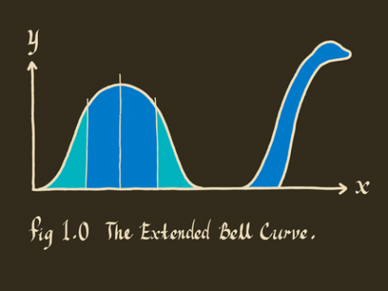
6.2 Normal Distribution
http://delfe.tumblr.com/

Slide 2
6.2/6.5: The Normal Distribution The Normal Approximation to the Binomial Distribution - Goals
Be able to sketch the normal distribution.
Be able to standardize a value.
Be able to use the Z-table.
Be able to calculate probabilities.
Be able to calculate percentiles (Inverse calculations).
Determine when you can use the normal approximation to the binomial and perform calculations using this approximation.

Slide 3
Normal Distribution
$$f\left(x\right)=\frac{1}{σ\sqrt{2π}}e^{−\frac{{(x−μ)}^{2}}{2σ^{2}}}$$
where -∞ < μ < ∞, σ > 0
X ~ N(μ,σ²)

Slide 4
Shapes of Normal Density Curve
http://resources.esri.com/help/9.3/arcgisdesktop/com/gp_toolref
/process_simulations_sensitivity_analysis_and_error_analysis_modeling
/distributions_for_assigning_random_values.htm

Slide 5
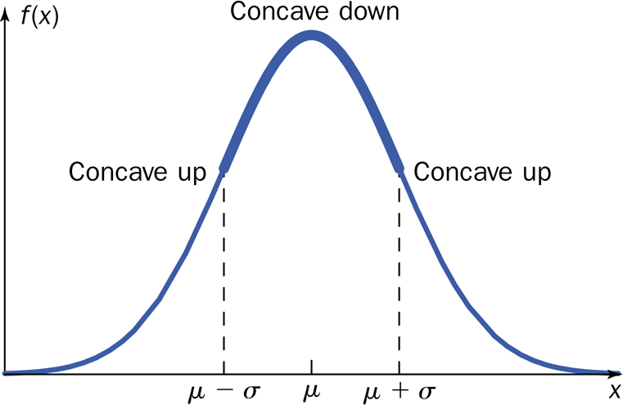
Graph of Normal Distribution

Slide 6
Standard Normal Distribution (z curve)
$$f\left(x\right)=\frac{1}{σ\sqrt{2π}}e^{−\frac{{(x−μ)}^{2}}{2σ^{2}}} f\left(z\right)=\frac{1}{\sqrt{2π}}e^{−\frac{z^{2}}{2}}$$
where -∞ < μ < ∞, σ > 0 μ = 0, σ² = 1

Slide 7
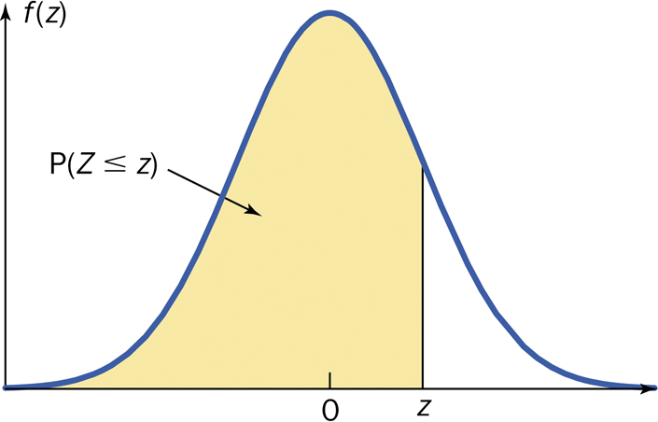
Cumulative z curve area

Slide 8
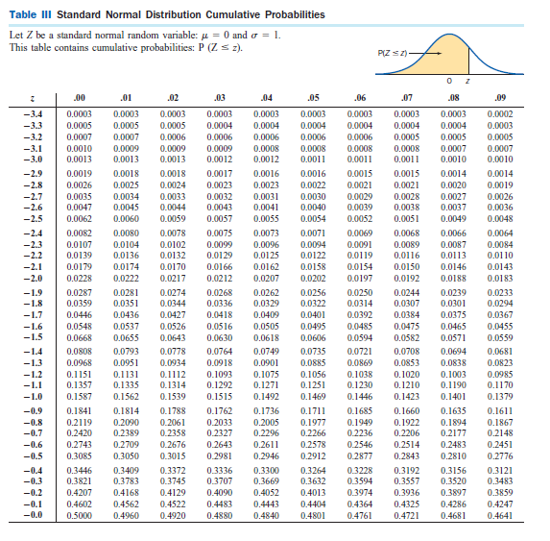
Z-table

Slide 9
Using the Z table
area right of z = 1 − area left of z
area between z₁ and z₂ = area left of z₁ – area left of z₂

Slide 10
Procedure for Normal Distribution Problems
Sketch the situation and shade the area to be found. Optional but extremely useful.
Standardize X to state the problem in terms of Z.
Use Table III to find the area to the left of z.
Calculate the final answer.
Write your conclusion in the context of the problem.
$$Z=\frac{X−μ}{σ}$$

Slide 11
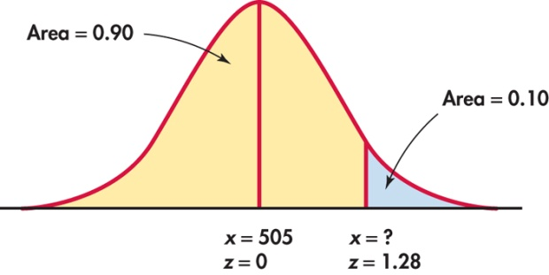
Percentiles
$$Z=\frac{X−μ}{σ}$$

Slide 12
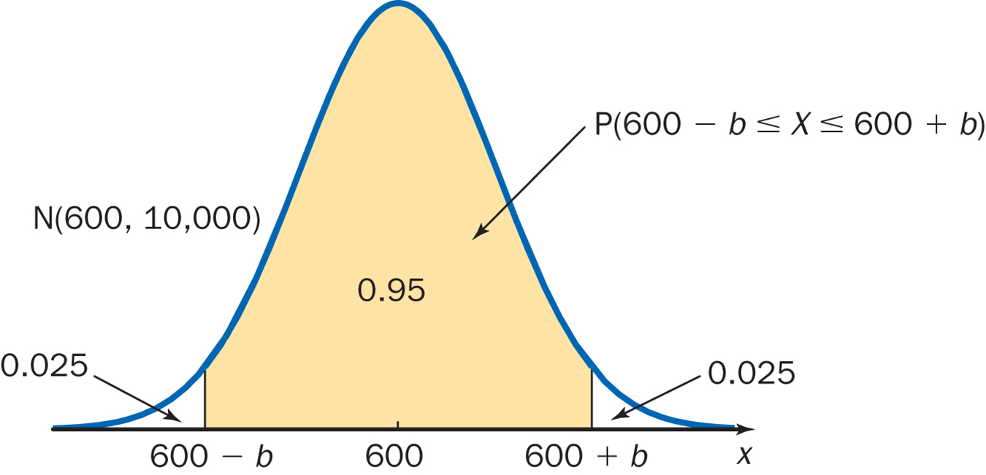
Symmetrically Located Areas

Slide 13
Why Approximate the Binomial Distribution?
Intervals
Computation (n large)
Inference

Slide 14
Difficulties with the Normal Approximation to the Binomial
Skewedness of the Binomial Distribution.
The Binomial Distribution is discrete.

Slide 15
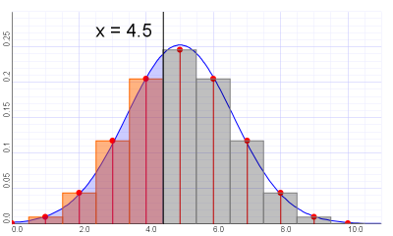
Continuity Correction
http://wiki.axlesoft.com/index.php?title=Continuity_correction

Slide 16
Continuity Correction
Actual Value | Approximate Value
P(X = a) | P(a – 0.5 < X < a +0.5)
P(a < X) | P(a + 0.5 < X)
P(a ≤ X) | P(a – 0.5 < X)
P(X < b) | P(X < b – 0.5)
P(X ≤ b) | P(X < b + 0.5)

